Slide 1

Getting started with collaboration on GitHub: Crunching webinar attendance data with R and Shiny

Slide 2






Notes:
The popularity of webinars and similar online events has increased in the last few years, but for an analyst involved in hosting, the lack of quality and accurate data about participation in the event was infuriating.
This project started life with frustration in a spreadsheet, moving to a simple script in R.

Slide 3

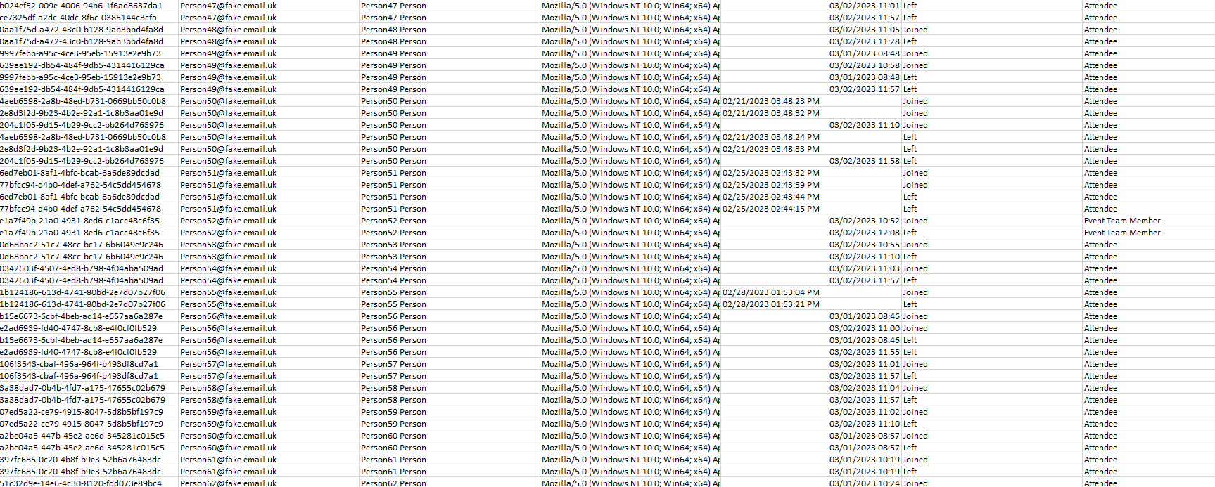
Notes:
Mess in the spreadsheet exported by teams

Slide 4
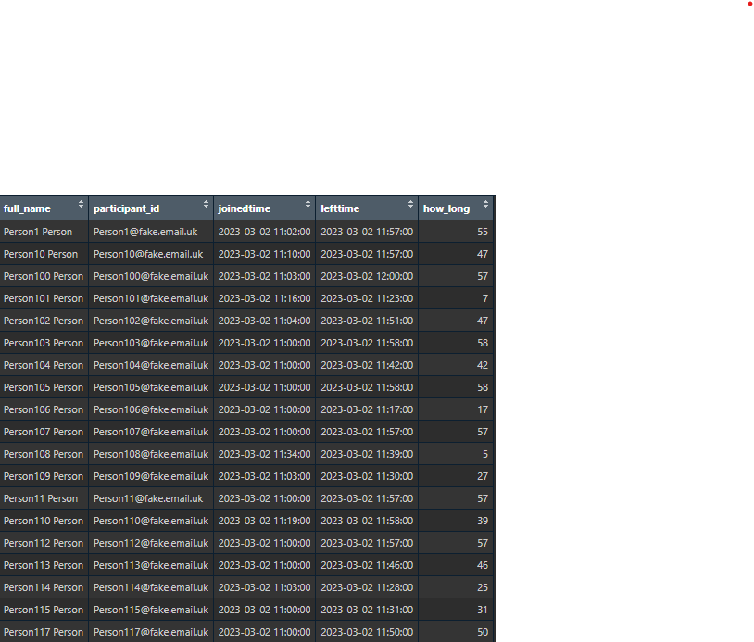
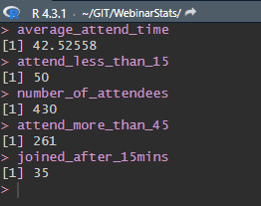
Notes:
Wrote about 70 lines of code to get to this

Slide 5

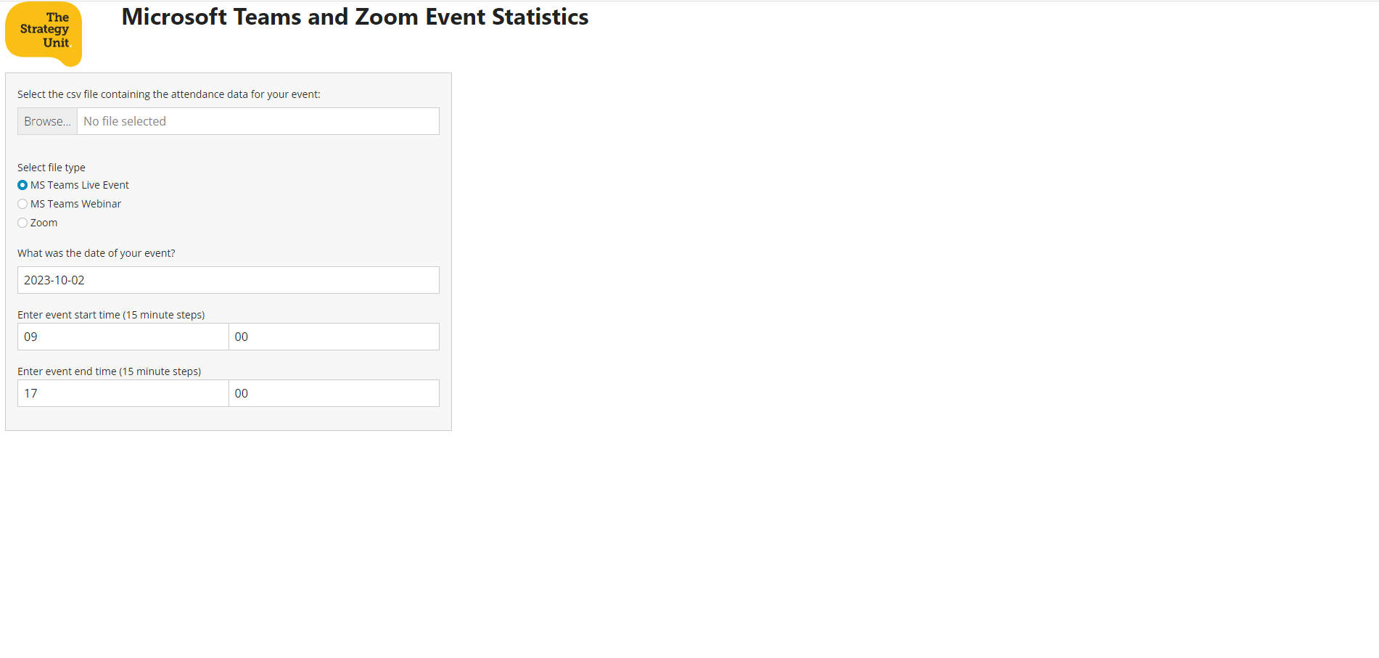
Notes:
Conversations with colleagues showed there was interest in something more and before long ideas had formed of something in Shiny and an early prototype was underway. This led to a public repository on GitHub, a demonstration to colleagues, and involvement of others; contributing issues, suggesting ideas and developments. The project has served a dual purpose, as a useful tool, and as a vehicle from which to practice collaborating via GitHub.

Slide 6
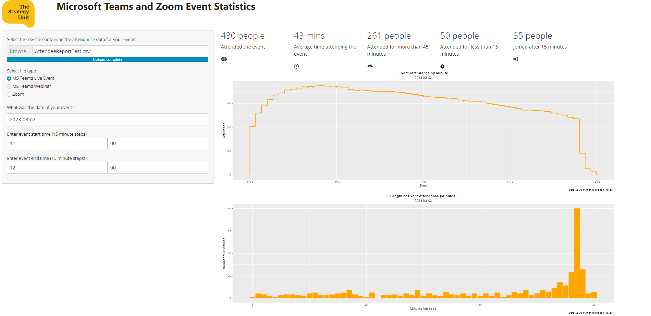

Slide 7
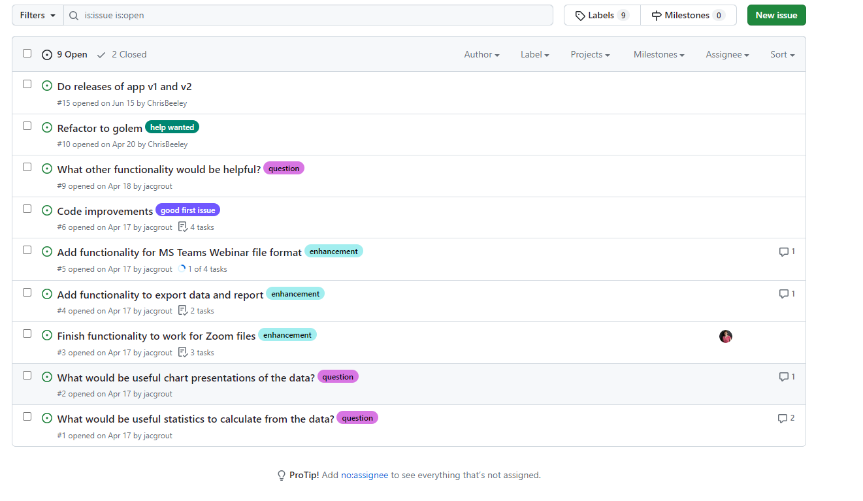

Slide 8
Notes:
Thus far we now have a Shiny app with functionality that allows selection of the attendee engagement report from a MS Teams Live Event, auto determines the date and timings of the event and generates statistics and chart presentations such as how many attended, how long they attended for, method of attending, promptness, and a survival analysis. It is also possible to export the cleaned up and organised attendance data, and to export presentations for use in project reports.

Slide 9
Notes:
The GitHub issues still include a number of suggestions for additional functionality and code improvements. So, if this project is of use and interest to you and you’re looking to develop your GitHub collaboration skills then watch this talk, visit the repository on GitHub and join in the fun.

Slide 10
Questions
What would be useful statistics to calculate from the data?
What would be useful chart presentations of the data?
What other functionality would be helpful?
Does anyone know how to make fancy dashboard style blocks containing data in shiny, but without shinydashboard, or maybe it has to be re-written and use shinydashboard?
Does anyone want to help with the project? (otherwise I might get bored and never finish it!)

Slide 11
Coffee and coding …….
It’s public on the Strategy Unit GitHub account
https://github.com/The-Strategy-Unit/WebinarStats
It makes a nice project to practice using and collaborating on GitHub
It’s a “would be nice” so no time pressure
It’s not for a client project so its “low stakes”
Small quick tasks to contribute
It demonstrates that a project is not just about “the code”

